Slide 1

By:- Furqan Wahid Moon
Netflix TV Shows & Movies
October 24,2025
Elevated Labs

Slide 2

Agenda
Introduction
Analysis from the Dataset
Conclusion

Slide 3

Introduction
Netflix is one of the world’s leading streaming entertainment platforms, offering a vast library of movies, TV shows, documentaries, and original productions available on-demand.
Founded in 1997 by Reed Hastings and Marc Randolph in California, Netflix began as a DVD rental-by-mail service. Over the years, it transformed into a global streaming giant, launching its online streaming service in 2007.
Today, Netflix operates in 190+ countries and serves over 260 million subscribers worldwide (as of 2025). The platform’s success is built on its:
Extensive content library across multiple genres and languages
High-quality Netflix Originals, such as Stranger Things, Money Heist, and The Crown
Personalized recommendations powered by advanced AI and data analytics
Netflix has revolutionized the way audiences consume entertainment, shifting from traditional TV and cinema to on-demand digital viewing. Its focus on innovation, global storytelling, and user experience continues to make it a leader in the streaming industry.

Slide 4

Analysis from the Dataset
Let’s dive in

Slide 5
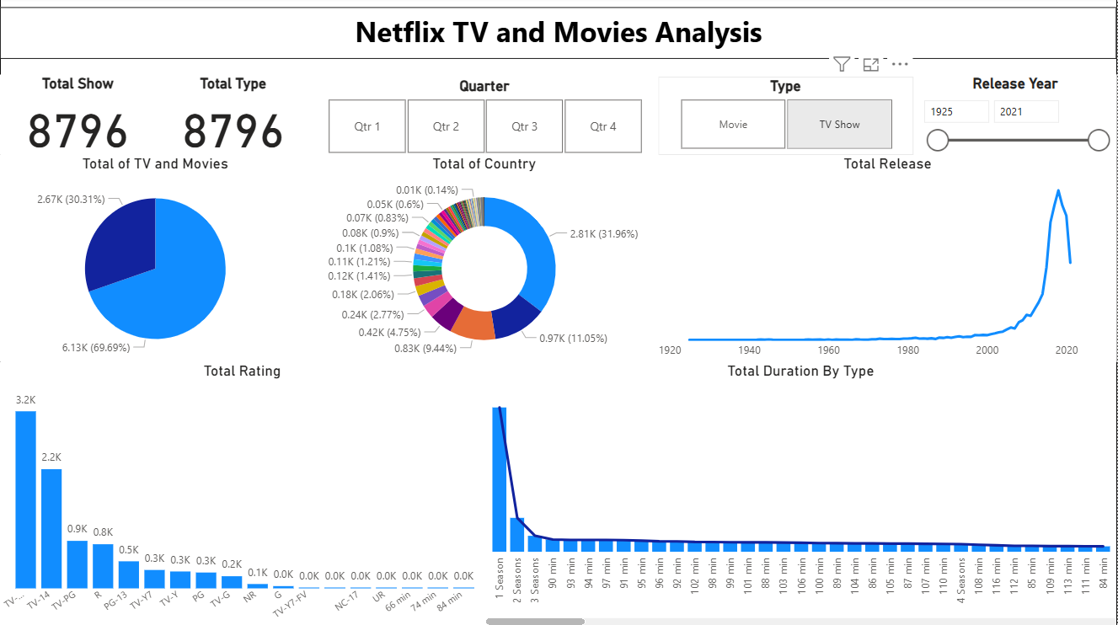

Slide 6
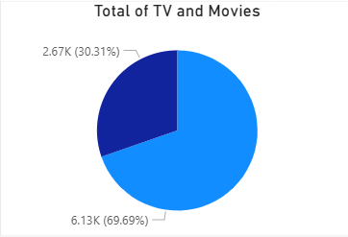
KPI 1
Type Distribution
Movies: 6.13K titles (≈70%)
TV Shows: 2.67K titles (≈30%)
Netflix’s catalog is dominated by movies, which make up two-thirds of the total content.

Slide 7
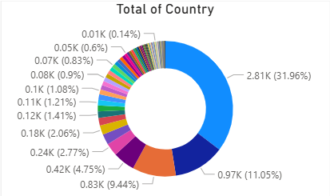
KPI 2
Country-Wise Distribution
The largest contributor country has 2.81K titles (≈32%).
The next two countries have 0.97K (≈11%) and 0.83K (≈9%), respectively.
Many other countries contribute smaller portions (under 5%).
A few countries dominate Netflix’s content, likely including the U.S., India, and the U.K., while other nations contribute minimally.

Slide 8
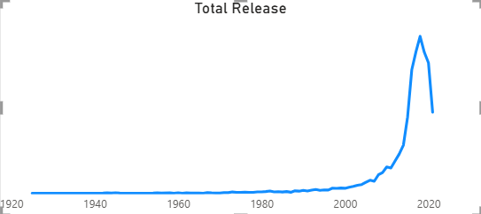
KPI 3
Release Trend
The chart shows releases from 1925 to 2021.
There is very little content before 2000, followed by a sharp increase after 2010, peaking around 2020.
Netflix’s content library has grown exponentially in recent years, especially with the rise of Netflix Originals and global expansion.

Slide 9
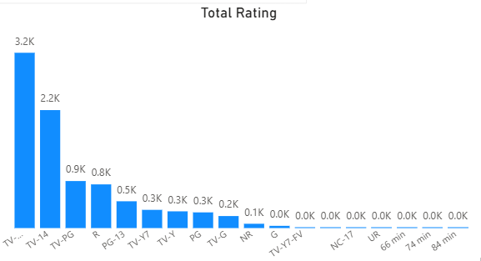
KPI 4
Ratings Distribution
Top ratings:
  TV-MA (Mature Audience) → 3.2K titles
  TV-14 → 2.2K titles
  TV-PG / R / PG-13 follow next with fewer titles.
Very few titles are G-rated (kids) or unrated (NR/UR).
Most of the Netflix’s content is aimed at mature audiences, with limited family or kids’ programming.

Slide 10
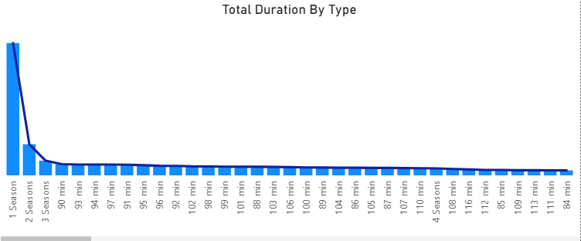
KPI 5
Duration / Seasons Distribution
For TV shows, most have 1 season, followed by a sharp drop for 2–3 seasons.
For movies, most have a runtime between 90–100 minutes.
Netflix prefers short to medium-length movies (around 1.5 hours).
Single-season TV shows dominate, possibly due to limited series or new originals.

Slide 11

KPI 6
Total of KPI Cards
Total Titles (Movies + TV Shows): 8,796
This represents the entire Netflix content dataset analyzed.
The same number (8,796) appears under both “Total Show” and “Total Type,” meaning every record in the dataset is counted once — whether a movie or a TV show.

Slide 12
Conclusion
Netflix’s catalog is movie-heavy (70%) but with a strong TV presence (30%).
The U.S. and a few key markets produce most of the content.
Mature-rated shows (TV-MA, TV-14) dominate the platform.
The content library has surged post-2010, aligning with Netflix’s global growth.
Short-format and single-season series are the most common structures.

